Slide 1
Software as a Service Provider
SAP Business ByDesign

Slide 2
Cloud Computing Home Assignment
BE-E-61: Sayali Shinde
BE-E-39: Kanchan Kharabi
BE-E-33: Manisha Hagawane
BE-E-19: Poonam Bagate

Slide 3
SaaS
SaaS is an architectural paradigm where a solution architecture can benefit from the economies of scale of the data and behavior of that architecture being built and hosted in the cloud by a third party in a multitenant fashion.
Software as a service (SaaS) is a software licensing and delivery model in which software is licensed on a subscription basis and is centrally hosted..

Slide 4
SAP Business ByDesign
SAP Business ByDesign is software as a service sold by SAP SE, a German software company.
It is an enterprise resource planning and business management software product designed for small and medium sized enterprises.
SAP announced SAP Business ByDesign on 19 September 2007 during an event in New York. It was previously known under the code name "A1S".

Slide 5
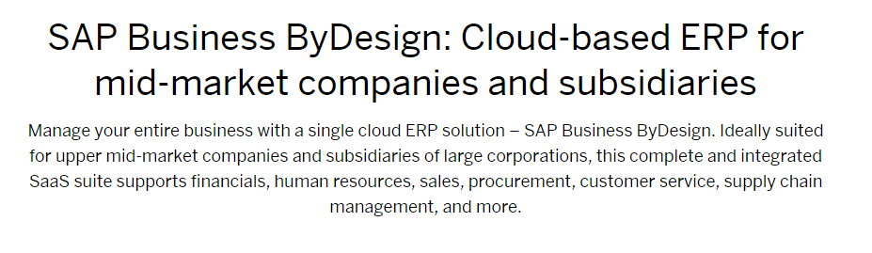
How SAP Business ByDesign describes itself?

Slide 6
SAP Business ByDesign
It is built on the principles of a service oriented architecture (SOA). Integration between business capabilities is accomplished via messages.
The underlying technology stack is a multi-tenancy enabled SAP NetWeaver stack, leveraging SAP's in-memory HANA database.

Slide 7
Why SAP Business ByDesign?
Because the cloud-based business management software support everything from finance to CRM – and is available anytime, anywhere, on almost any device. It helps medium-sized businesses seize new opportunities and accelerate growth – and it helps subsidiaries take advantage of head office resources, while keeping their flexibility.
Streamline end-to-end processes and maximize efficiency across your organization
Gain timely business insights with integrated analytics and reporting powered by SAP HANA
Manage your business from anywhere, at any time, with built-in mobile apps
Rely on highly secure data centers that are managed, monitored, and maintained by SAP experts

Slide 8
Service Oriented Architecture
A service-oriented architecture (SOA) is an architectural pattern in computer software design in which application components provide services to other components via a communications protocol, typically over a network. The principles of service-orientation are independent of any vendor, product or technology.

Slide 9
Formal Definitions of SOA
A paradigm for organizing and utilizing distributed capabilities that may be under the control of different ownership domains. It provides a uniform means to offer, discover, interact with and use capabilities to produce desired effects consistent with measurable preconditions and expectations.
Service-Oriented Architecture (SOA) is an architectural style that supports service-orientation. Service-orientation is a way of thinking in terms of services and service-based development and the outcomes of services.
A service:
- Is a logical representation of a repeatable business activity that has a specified outcome (e.g., check customer credit, provide weather data, consolidate drilling reports)
- Is self-contained
- May be composed of other services
- Is a "black box" to consumers of the service

Slide 10
SOA
The purpose of SOA is to allow users to combine fairly large chunks of functionality to form ad hoc applications built almost entirely from existing software services.
The larger the chunks, the fewer the interfaces required to implement any given set of functionality; however, very large chunks of functionality may not prove sufficiently granular for easy reuse.
Each interface brings with it some amount of processing overhead, so there is a performance consideration in choosing the granularity of services.

Slide 11
SOA Framework – Horizontal Layers
SOA-based solutions endeavour to enable business objectives while building an enterprise-quality system. SOA architecture is viewed as five horizontal layers:
Consumer Interface Layer – These are GUI for end users or apps accessing apps/service interfaces.
Business Process Layer – These are choreographed services representing business use-cases in terms of applications.
Services – Services are consolidated together for whole-enterprise in-service inventory.
Service Components – The components used to build the services, such as functional and technical libraries, technological interfaces etc.
Operational Systems – This layer contains the data models, enterprise data repository, technological platforms etc.

Slide 12
SOA Framework – Vertical Layers
There are four cross-cutting vertical layers, each of which are applied to and supported by each of the following horizontal layers:
Integration Layer – starts with platform integration (protocols support), data integration, service integration, application integration, leading to enterprise application integration supporting B2B and B2C.
Quality of Service – Security, availability, performance etc. constitute the quality of service parameters which are configured based on required SLAs, OLAs.
Informational – provide business information.
Governance – IT strategy is governed to each horizontal layer to achieve required operating and capability model.

Slide 13
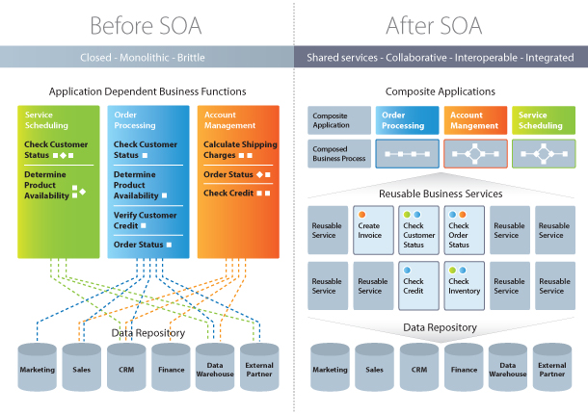
SOA Framework

Slide 14
Current Customers of SAP Business ByDesign - Skullcandy
Skullcandy makes some of the coolest headphones, ear buds and gaming headsets on the market. They are using SAP Business ByDesign for ‘International Functionality’, ‘Agility’, ‘Accepting Orders and Fulfilling them’.
ByDesign helps to configure and adapt as you grow.

Slide 15
Current Customers of SAP Business ByDesign - Hilti
Hilti supplies power tools to companies around the world.
They are using SAP Business ByDesign to give their subsidiaries, resellers and distributors access to the same ERP tools as the main offices.

Slide 16


The mantra is “Software as a Service”
A business or consumer application offered as a multi-tenanted instance providing variable pricing plans based upon usage and deployed via web services in an on-demand environment.
ASP Implementation
SaaS Implementation
Delivery of packaged Software over the Internet.
Minimal optimization for access over a network.
Not scaleable for thousands of users.
Strict pricing plans. Usually based on per seat.
Complex application integration for customers.
Dissatisfaction with mass customization
Primary focus was internet security and end-user portals.
Designed to be deployed to multiple end customers via one instance.
Utilizes web services & standards for integration.
Component architecture that may be used by other apps regardless of platforms.
SLAs standard.
Flexible pricing based on metering of application usage.
New business models and Partnership with infrastructure providers for sales & channel reach.
- VS -

